Slide 1
IoT BASED HEALTH CARE SUPPORT SYSTEM
Dipti Pamnani

Slide 2
Problem statement:
In today’s world many people tend to affect their health unknowingly due to many factors, majorly comprising of factors such as pollution and smoke.
Thus there is a need to reform the health care delivery system to improve the quality of life for each community in the ecosystem, and provide better health care solutions to mitigate the probable future risks that could arise based on current analysis.

Slide 3
Internet of Things can act as a medium to mitigate the above stated problem.
Internet of Things will help to capture the real time data with the help of sensors
The sensors will act as a medium of integration between the physical world and the smart computer-based systems.
Problem solution:

Slide 4
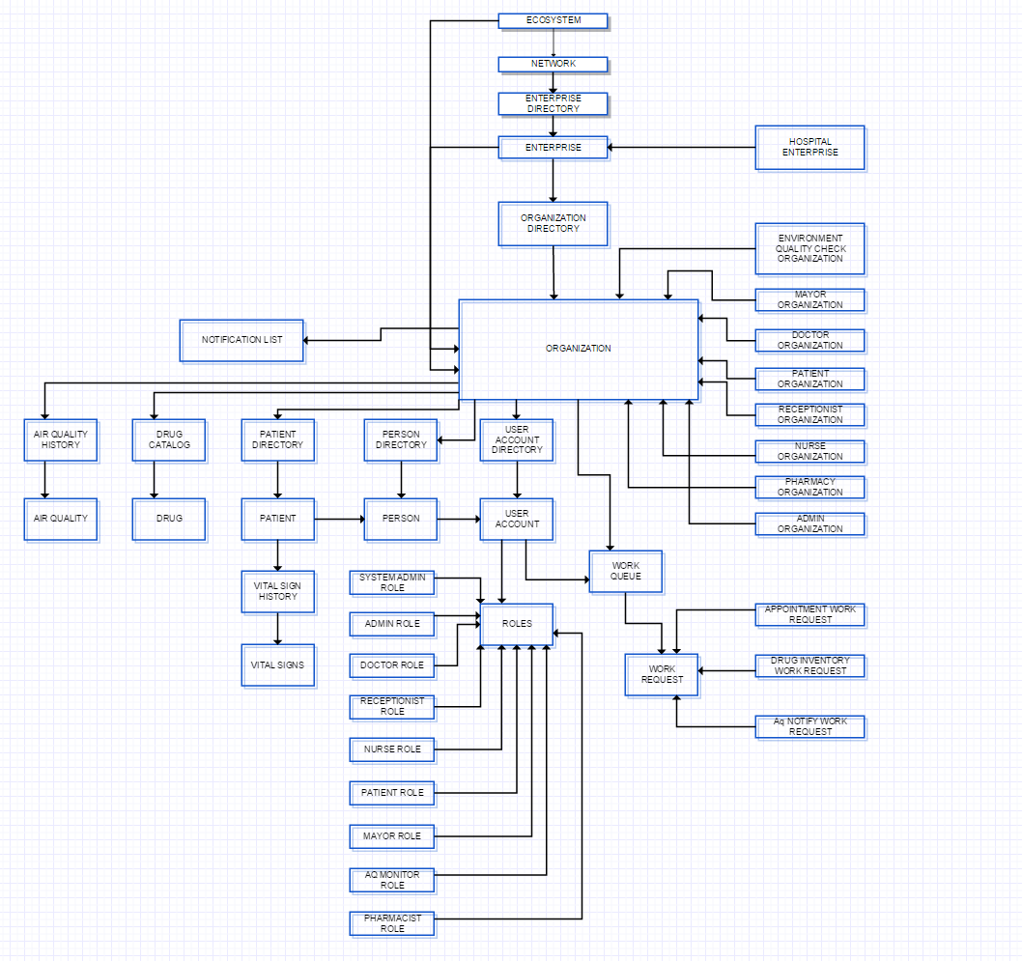
Object diagram :

Slide 5
Features of the project :
Managing the Hospital enterprise and the in-patients of the hospital.
Air Quality Monitoring sensors will determine the quality of air in the environment and raise an alert to the hospital organization.
Use of sensors to track the real-time Vital Signs of the patient.
Manage different Organizations of the enterprise and the communication between them.

Slide 6
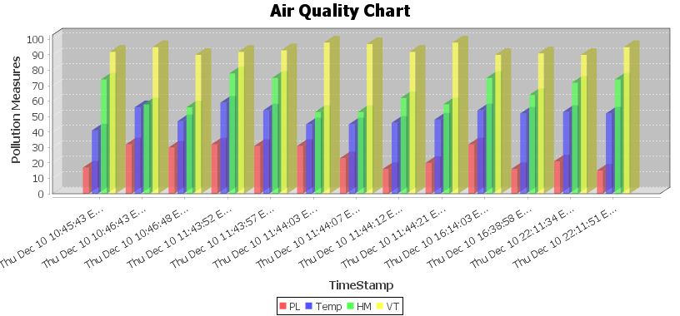
Mayor is associated with the enterprise, the mayor analyzes the data about air quality and can compare with the historic data.
This will help him take the necessary steps for the betterment of the community as a whole.

Slide 7
Future scope :
Managing different enterprises of a network.
Tracking the Air Quality of the entire city and its impact on every possible entity in the community.

Slide 8
lets go to the demo

